Slide 1


GBME Probability and Statistics | Fall 2018
Lecture 07 | 100118
Lecture 07
Regression wisdom, re-expressing data
sampling
CHOONG-WAN WOO | COCOAN lab | http://cocoanlab.github.io

Slide 2
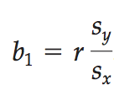
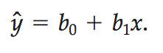
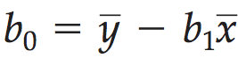
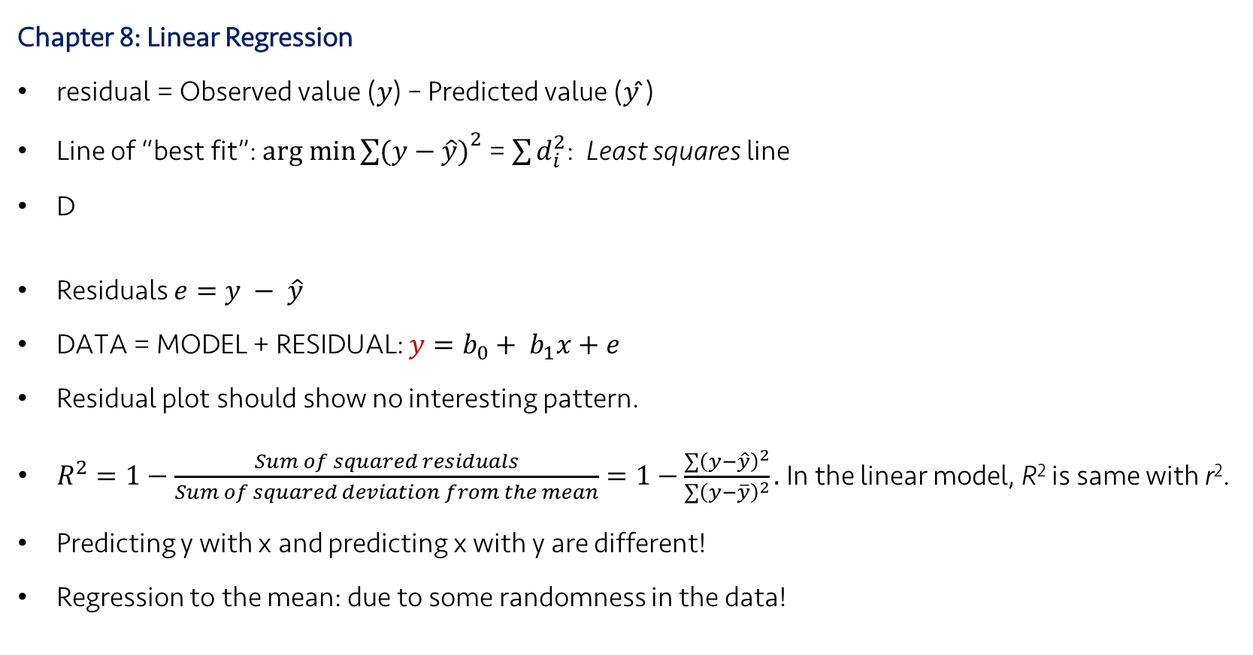
Lecture 07 | 100118
Review: Key Points
Chapter 8: Linear Regression
residual = Observed value (𝑦) – Predicted value (𝑦 ̂)
Line of “best fit”: $arg min{\sum{(y−\hat{y})}}^{2}$ = $\sum{d_{i}^{2}}$: Least squares line
D
Residuals $e=y − \hat{y}$
DATA = MODEL + RESIDUAL: $y=b_{0}+ b_{1}x+e$
Residual plot should show no interesting pattern.
$R^{2}=1−\frac{Sum of squared residuals}{Sum of squared deviation from the mean}=1−\frac{\sum{{\left(y−\hat{y}\right)}^{2}}}{\sum{{\left(y−\overline{y}\right)}^{2}}}.$In the linear model, R² is same with r².
Predicting y with x and predicting x with y are different!
Regression to the mean: due to some randomness in the data!
Slope,
Intercept,
CHOONG-WAN WOO | COCOAN lab | http://cocoanlab.github.io

Slide 3
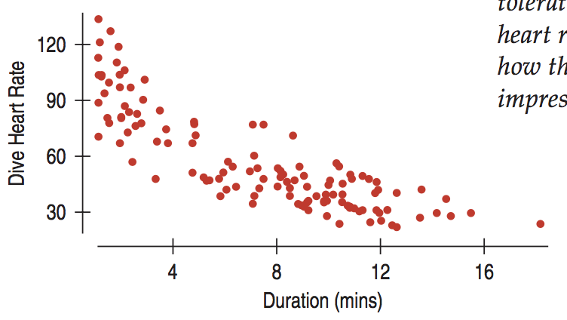
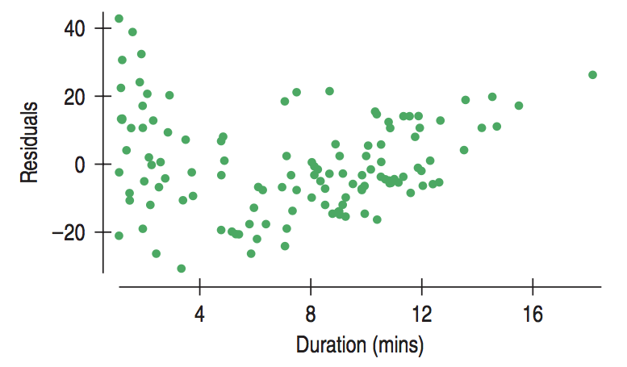
Lecture 07 | 100118
Regression wisdom
“Bends” is often not apparent in the scatterplot of raw data. Residual plots will help!
CHOONG-WAN WOO | COCOAN lab | http://cocoanlab.github.io

Slide 4
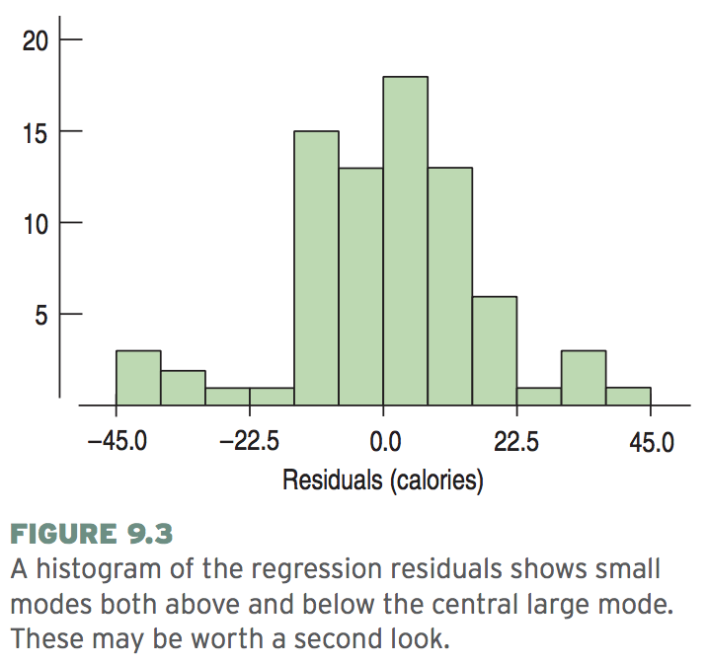
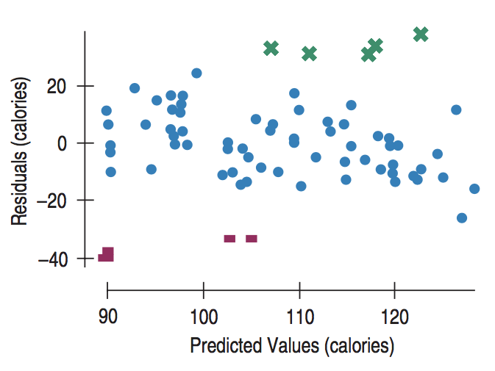
Lecture 07 | 100118
Regression wisdom
“Bends” is often not apparent in the scatterplot of raw data. Residual plots will help!
Subgroups? Look at the histogram of the residuals
CHOONG-WAN WOO | COCOAN lab | http://cocoanlab.github.io

Slide 5
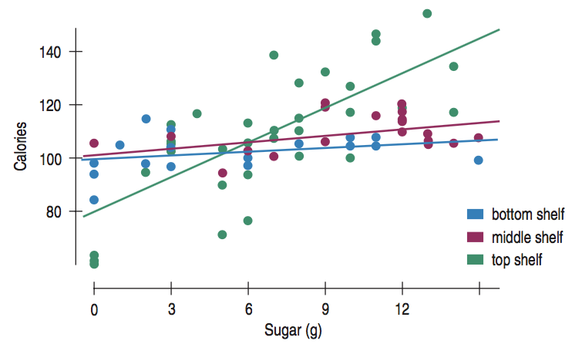
Lecture 07 | 100118
Regression wisdom
“Bends” is often not apparent in the scatterplot of raw data. Residual plots will help!
Subgroups? Look at the histogram of the residuals
If you already know there are different groups, get the regression lines separately.
CHOONG-WAN WOO | COCOAN lab | http://cocoanlab.github.io

Slide 6
Lecture 07 | 100118
Regression wisdom
“Bends” is often not apparent in the scatterplot of raw data. Residual plots will help!
Subgroups? Look at the histogram of the residuals
If you already know there are different groups, get the regression lines separately.
Extrapolation is not warranted (sampling bias, generalization error)
No causation!
Outlier!
CHOONG-WAN WOO | COCOAN lab | http://cocoanlab.github.io

Slide 7
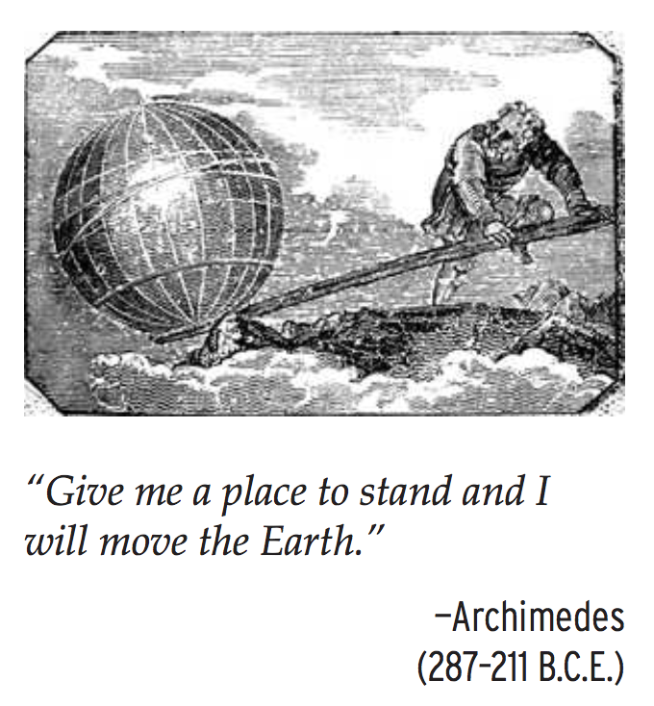
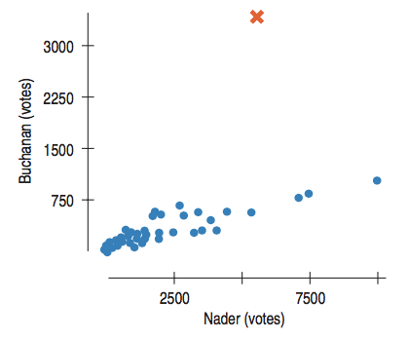
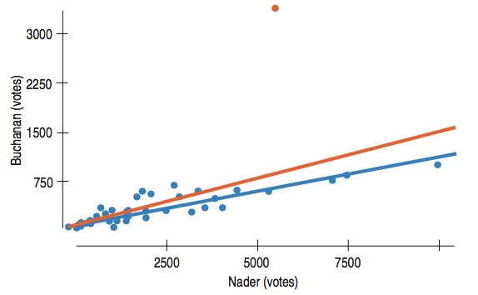
Lecture 07 | 100118
Regression wisdom
Not so much change in line,
but the outlier drops R² a lot!
R² = .821 → R² = .428
CHOONG-WAN WOO | COCOAN lab | http://cocoanlab.github.io

Slide 8
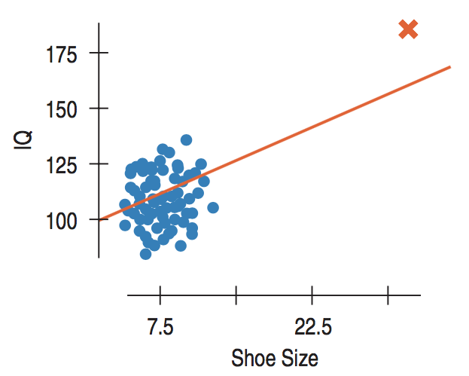
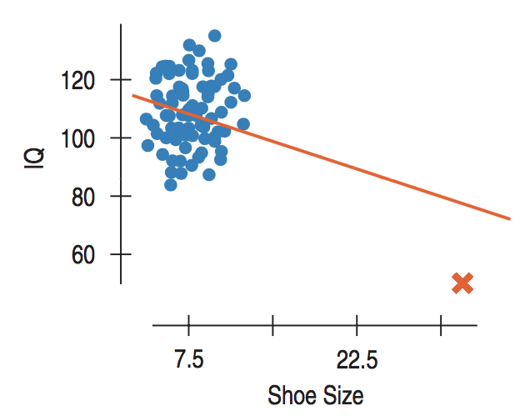
Lecture 07 | 100118
Regression wisdom
High leverage
changes line a lot
and increases R² a lot
CHOONG-WAN WOO | COCOAN lab | http://cocoanlab.github.io

Slide 9
Lecture 07 | 100118
Regression wisdom
“Bends” is often not apparent in the scatterplot of raw data. Residual plots will help!
Subgroups? Look at the histogram of the residuals
If you already know there are different groups, get the regression lines separately.
Extrapolation is not warranted (sampling bias, generalization error)
No causation!
Outlier!
Lurking variable (again)
Be cautious in working with summary statistics!
CHOONG-WAN WOO | COCOAN lab | http://cocoanlab.github.io

Slide 10
Lecture 07 | 100118
Re-expressing Data: Tukey’s Ladder
x: down
y: up
x, y: up
x, y: down
x: up
y: down
CHOONG-WAN WOO | COCOAN lab | http://cocoanlab.github.io

Slide 11
Lecture 07 | 100118
Re-expressing Data: Tukey’s Ladder
CHOONG-WAN WOO | COCOAN lab | http://cocoanlab.github.io

Slide 12
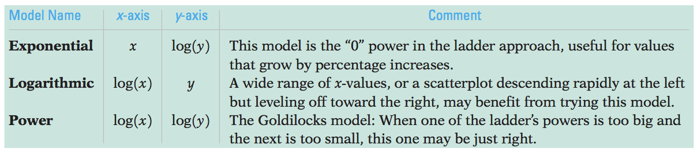
Lecture 07 | 100118
Re-expressing Data: Logarithms
When none of the data values is zero or negative:
Watch out for negative data values
one possible cure for zeros and small negative values is to add a constant.
Watch for data far from 1
may not be much affected by re-expression
consider subtracting a constant to bring them back near 1 (e.g., years, 2000 -> 1)
CHOONG-WAN WOO | COCOAN lab | http://cocoanlab.github.io

Slide 13
Lecture 07 | 100118
Key Points
Chapter 9 and 10: Regression wisdom, re-expressing data
Bends, subgroups, outliers
Cautious about extrapolation, causation, lurking variables, summary stats
Tukey’s ladder
CHOONG-WAN WOO | COCOAN lab | http://cocoanlab.github.io

Slide 14
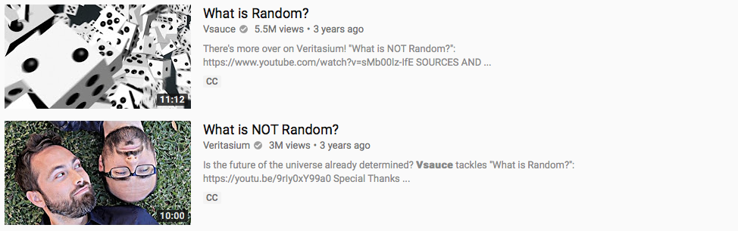
Lecture 07 | 100118
Randomness
Good videos:
https://www.youtube.com/watch?v=9rIy0xY99a0
https://www.youtube.com/watch?v=sMb00lz-IfE
CHOONG-WAN WOO | COCOAN lab | http://cocoanlab.github.io

Slide 15
Lecture 07 | 100118
Sampling
Idea 1: Examine a part of the whole
Population: the entire group of individuals
Sample: a smaller group of individuals, selected from the population
difficult to ensure the sample represents the population
Bias: over- or under-represent some characteristics of the population (e.g., Literary Digest Poll, they sampled response using phone calls when telephone was a luxury)
CHOONG-WAN WOO | COCOAN lab | http://cocoanlab.github.io

Slide 16
Lecture 07 | 100118
Sampling
Idea 1: Examine a part of the whole
Idea 2: Randomize
To make sure the sampling is not biased
CHOONG-WAN WOO | COCOAN lab | http://cocoanlab.github.io

Slide 17
Lecture 07 | 100118
Sampling
Idea 1: Examine a part of the whole
Idea 2: Randomize
Idea 3: Sample size matters
Important thing is not the fraction of the population, but the sample size.
Census: examine the entire population
It is difficult to complete a census
More noisy
They do not stand still
CHOONG-WAN WOO | COCOAN lab | http://cocoanlab.github.io

Slide 18
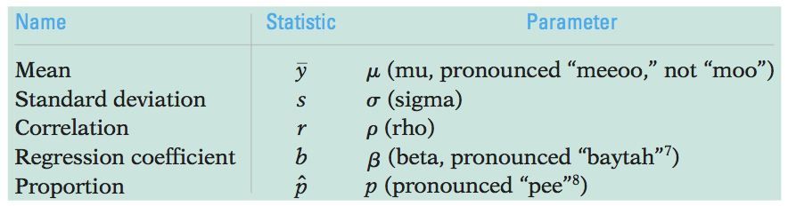
Lecture 07 | 100118
Populations and parameters
Population parameters: parameters to model for a population
Sample statistics (or statistics): summaries of sample data to estimate the population parameters
CHOONG-WAN WOO | COCOAN lab | http://cocoanlab.github.io

Slide 19
Lecture 07 | 100118
Sampling methods
Simple Random Sampling
Each person has an equal chance of being selected
Stratified Random Sampling
Strata: the population is first divided into homogeneous groups (e.g., male and female)
Then, simple random sampling within each stratum before the results are combined.
E.g., 60% men and 40% women in the campus: randomly sample 60 men and 40 women for 100 subjects
CHOONG-WAN WOO | COCOAN lab | http://cocoanlab.github.io

Slide 20
Lecture 07 | 100118
Sampling methods (cont’d)
Cluster Sampling
Splitting the population into representative clusters, first.
What’s different from stratified sampling? Clusters can be heterogeneous!
Multistage samples
combine several sampling methods
Systematic Samples
select samples systematically (e.g., survey every 10th person on the list)
CHOONG-WAN WOO | COCOAN lab | http://cocoanlab.github.io

Slide 21
Lecture 07 | 100118
Common Mistakes in sampling
Mistake 1: Sample Volunteers: voluntary response bias
Mistake 2: Sample Conveniently: may not be representative of the population
Mistake 3: Use a Bad Sampling Frame: incomplete sampling frame introduces bias
Mistake 4: Undercoverage: some portion of the population is not sampled at all
Mistake 5: Nonresponse Bias: those who don’t respond may differ from those who do
Mistake 6: Response Bias: anything survey design that influences the response
CHOONG-WAN WOO | COCOAN lab | http://cocoanlab.github.io

Slide 22
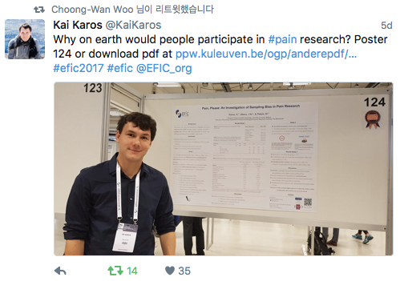
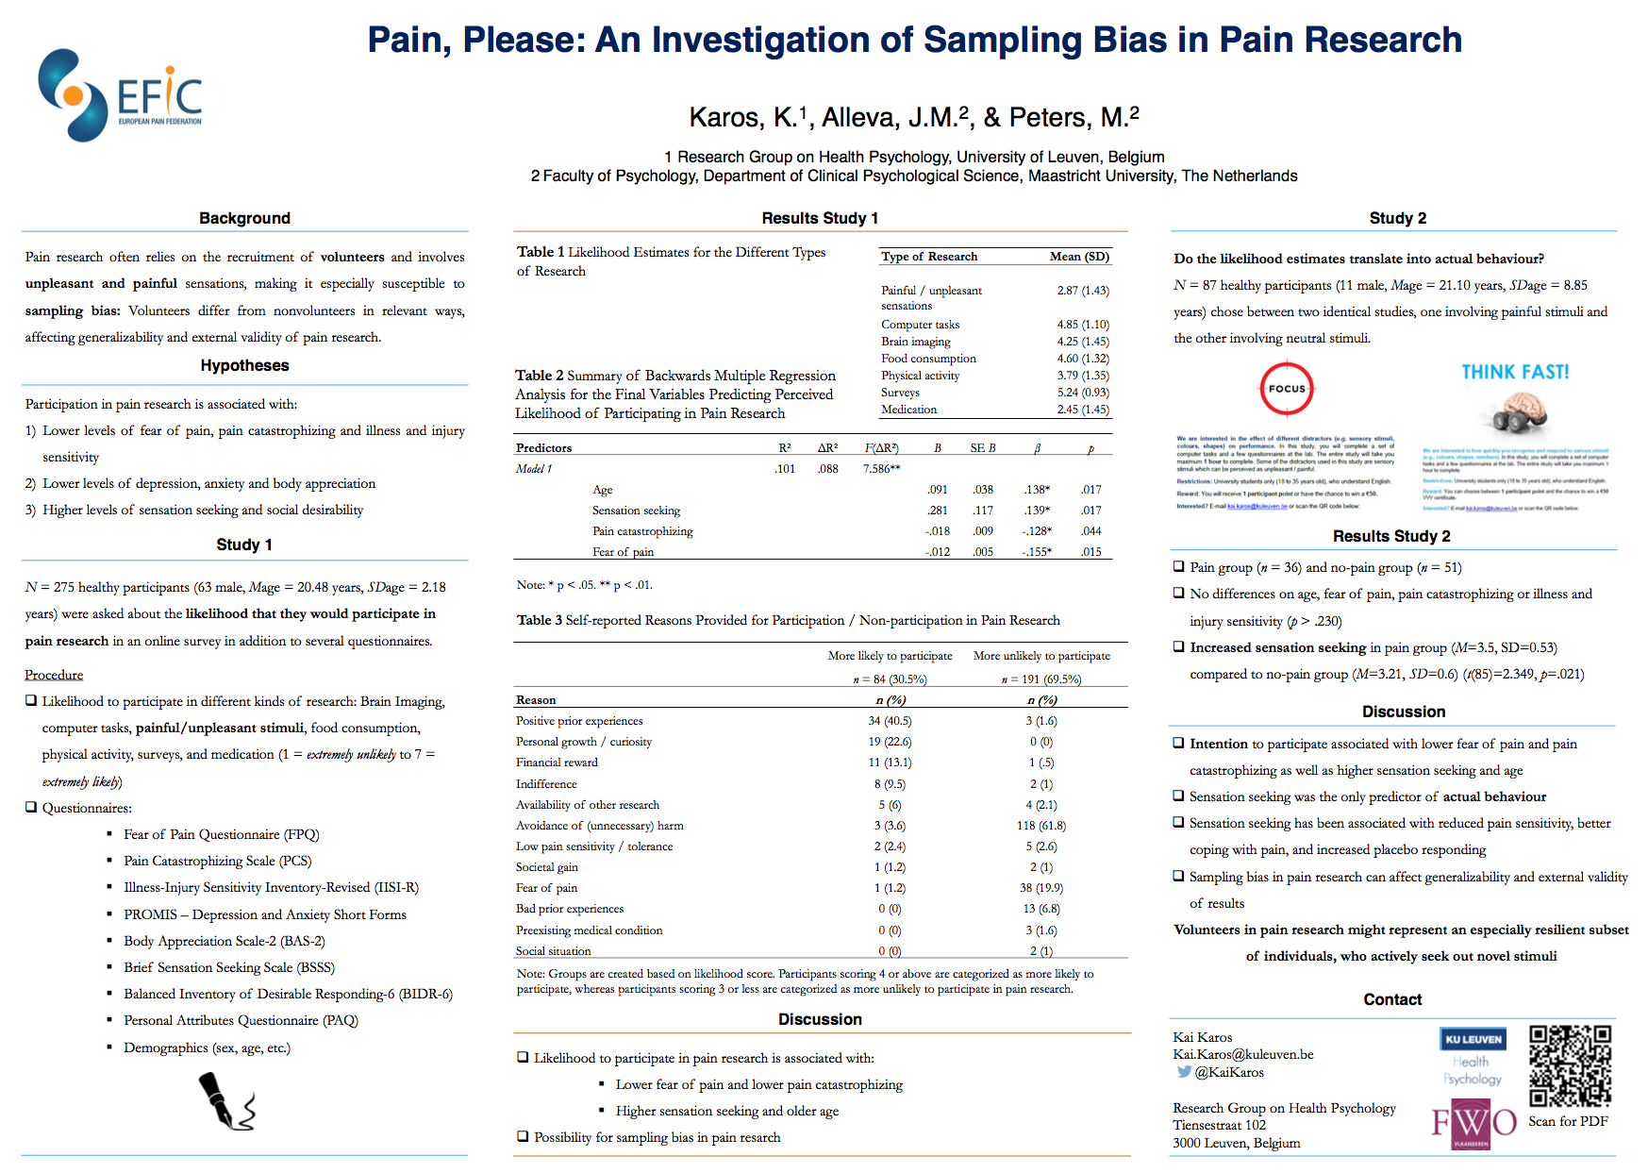
Lecture 07 | 100118
E.g., Sampling bias in pain research
https://ppw.kuleuven.be/ogp/anderepdf/efic-2017.pdf
CHOONG-WAN WOO | COCOAN lab | http://cocoanlab.github.io

Slide 23
Lecture 07 | 100118
Key Points
Chapter 9 and 10: Regression wisdom, re-expressing data
Bends, subgroups, outliers
Cautious about extrapolation, causation, lurking variables, summary stats
Tukey’s ladder
Chapter 11 and 12: Randomness, Sampling
Population parameters vs. sample statistics
Sampling methods:
Simple sampling, stratified sampling, cluster sampling, multistage sampling, systematic sampling
Common mistakes in sampling…
Next week (10/8): Chapter 13 and 14
CHOONG-WAN WOO | COCOAN lab | http://cocoanlab.github.io

